Slide 1








GROUP PROJECT 3
Presented by Team Number 3

Slide 2





Our Team
Alan Islas
Diego Rodriguez
Jorge Salazar

Slide 3








Theme
Topic 1: Data Modeling with sales DB
Topic 2: Data Visualization of sales trends per region

Slide 4




Background
For the marketing and commercial departments being able to visualize which products and clients are more relevant in each season allowed them to take decisions that provide added value for the business.
The present dashboard allows the user to select a region and to see the distribution of sales per product according to the region he selected. The second graph allows the user to define marketing activities bases on the season where the products are mostly needed. For the demand planning department being able to see sales trends is the basic input to decide which raw materials to buy.

Slide 5

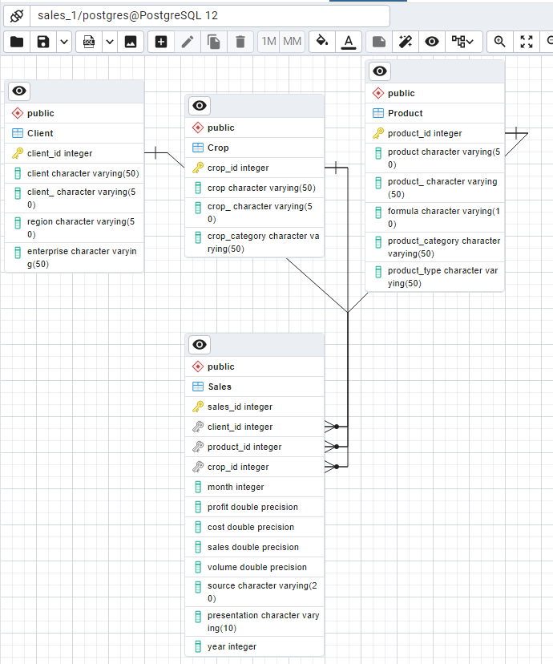
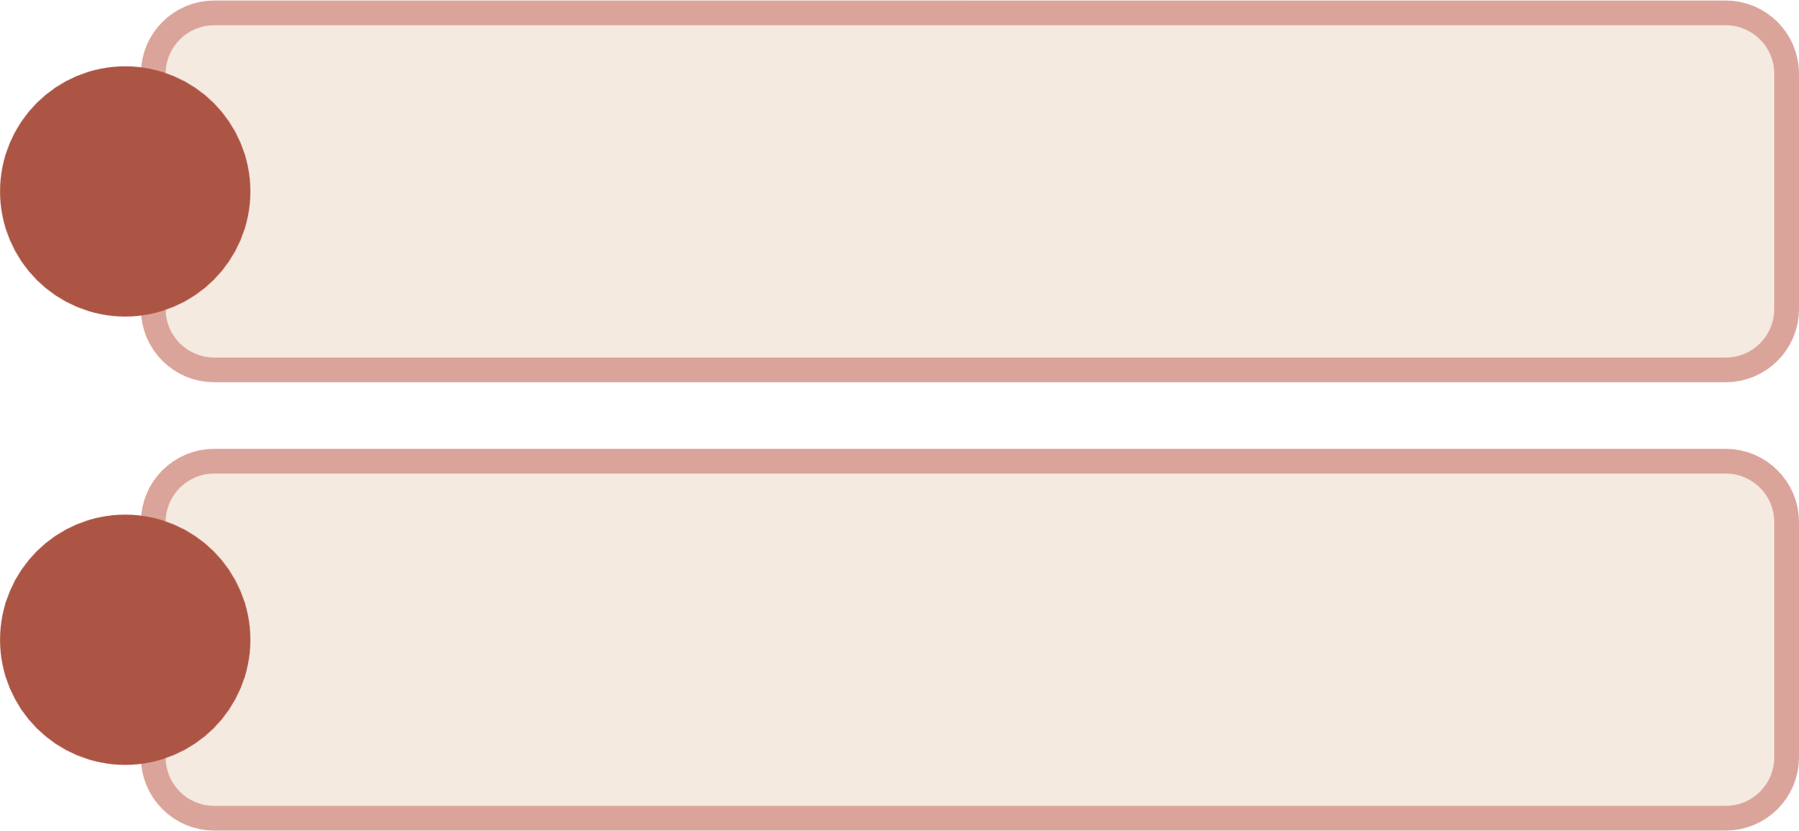
Coding Approach
Decided to use pgAdmin 4 as our database to act as the holder of the 4 csv files: client, product, crop and sales.
First, we created a schema to define the relationships between each table.
We used data modeling to optimize the performance of the DB assigning primary and foreign keys for each of the tables.
1.

Slide 6
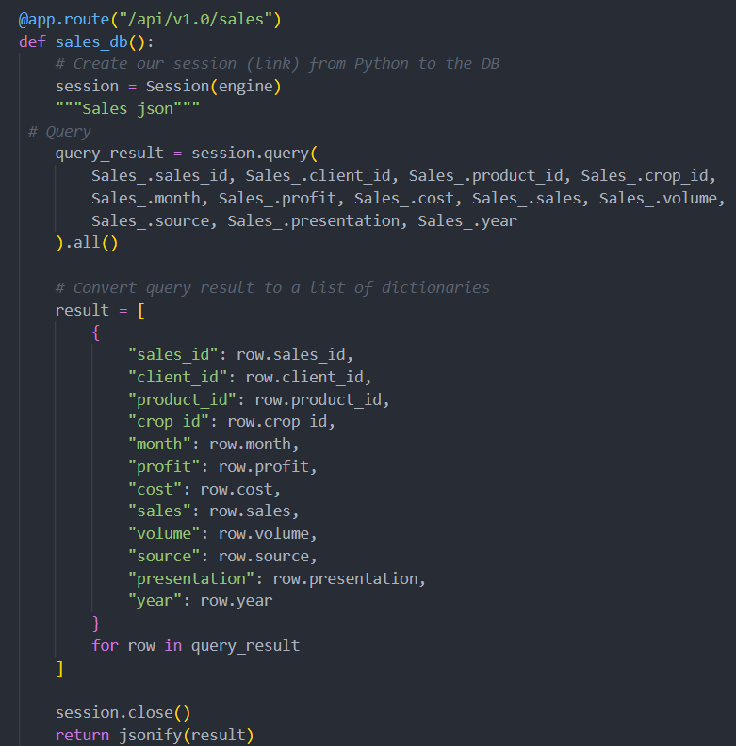
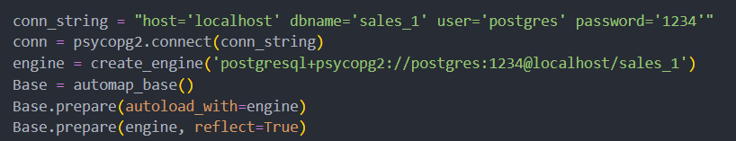
Coding Approach
Using python, psycopg2, we were able to connect to our DB and made our own Python flask API.
To convert our tabular structure into JSON format we used jsonify.
We created routes for each csv files.
2.

Slide 7
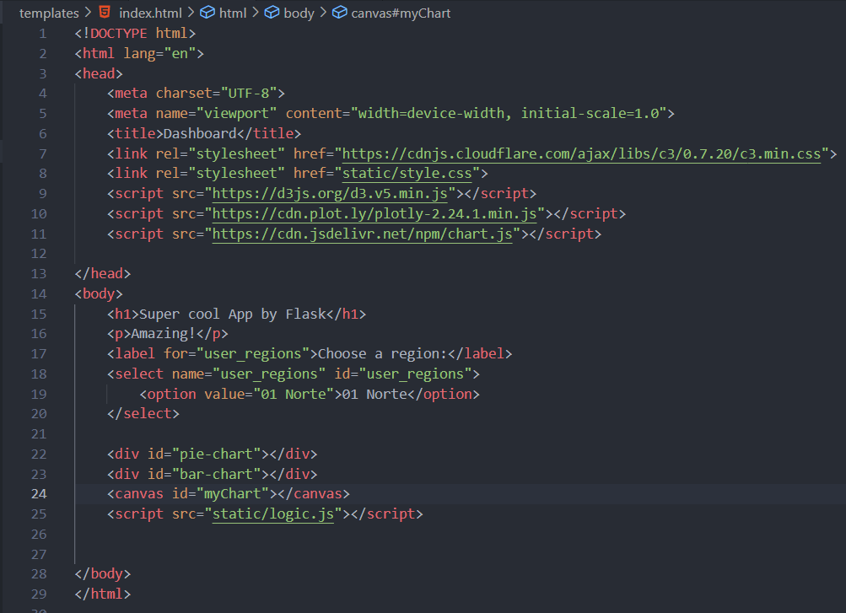
Coding Approach
Using JavaScript, we were able to retrieve the data from the previously defined routes. Created the HTML with the following structure: d3.js, plotly.js, chart.js, logic.js, style.css.
In that way we were able to connect to each of the sources required to build the dashboard.
3.

Slide 8
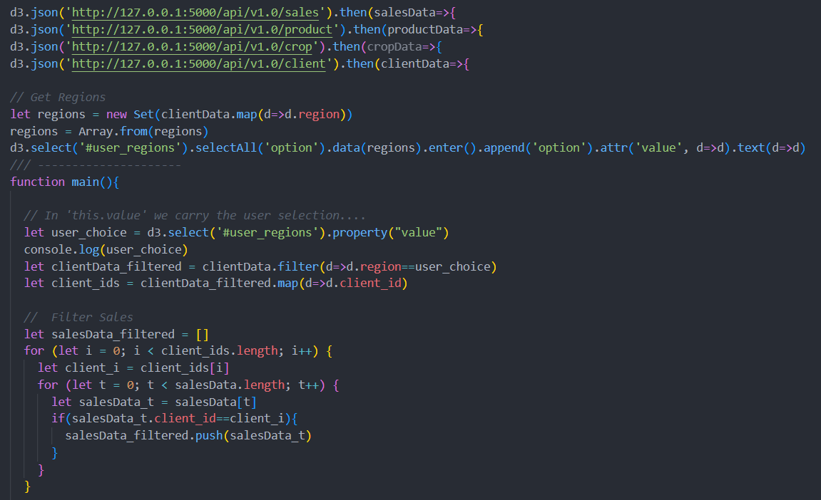
Coding Approach
We filtered the data based on the user selection; to merge the data in order to retrieve the product names of the auxiliary tables; to groupby product, month or client based on the graph we were planning to use.
4.

Slide 9
Results

Slide 10


Conclusion
Started creating JS code, encountered a BIG problem as our approach to analyze the data was with JS code instead of python making it way more challenging.
Cleaning and processing data is way easier in python than in javasacript.

